Slide 1
AI – Prof. R.G.Mehta
Brief introduction to AI
Goal-based agents
Representing states and operators
Example problems
State-space search algorithm(Graph searching)

Slide 2
Introduction
General mechanism of searching and present it in terms of searching for paths in directed graphs.
First define the underlying search space
Apply a search algorithm to that search space.
A (directed) graph consists of a set of nodes and a set of directed arcs between nodes.
The core idea is to find a path along these arcs from a start node to a goal node.
there may be more than one way to represent a problem as a graph.
state-space searching as graph search
Nodes represent states
arcs represent actions

Slide 3
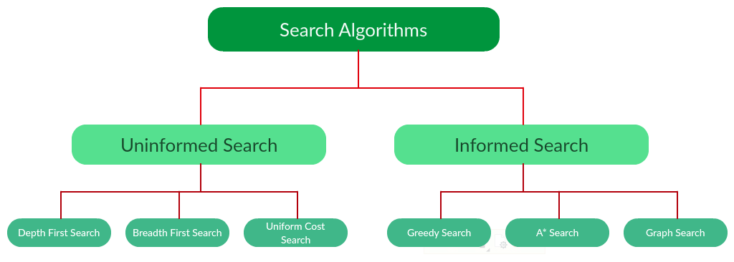
Brute Force Search
Heuristic Based Search

Slide 4
Other approaches
Brute-Force Approach
Heuristic Search
Two-Player-Games Search
Interleaving Search
Each of these algorithms will have:
A problem graph, containing the start node S and the goal node G.
A strategy, describing the manner in which the graph will be traversed to get to G.
A fringe, which is a data structure used to store all the possible states (nodes) that you can go from the current states.
A tree, that results while traversing to the goal node.
A solution plan, which the sequence of nodes from S to G.

Slide 5
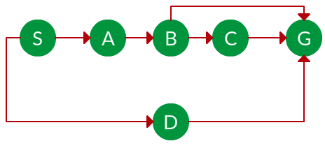
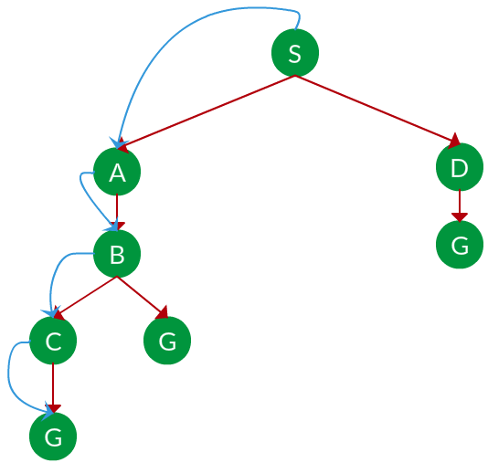
Search tree for Graph Search
Source : S
Goal : G

Slide 6
Brute-Force Approach
The most general search algorithms
No domain specific knowledge.
Require
a state description,
a set of legal operators,
initial state,
goal state.
Also called uninformed search and blind search.
proceed in a systematic way by exploring nodes in some predetermined order or simply by selecting nodes at random.
return
only a solution value when a goal is found
or
record and return the solution path.

Slide 7
Brute force Techniques
Generate-And-Test
Breadth-First Search
Uniform-Cost Search
Depth-First Search
Depth-First Iterative-Deepening Search
Bidirectional Search

Slide 8
Generate-And-Test Algorithm
very simple algorithm
guarantees to find a solution if
done systematically and
there exists a solution.
Algorithm:
Generate a possible solution.
Test to see if this is the expected solution.
If the solution has been found quit else go to step 1.
Potential solutions that need to be generated vary depending on the kinds of problems.
For some problems the possible solutions may be particular points in the problem space
For some problems, paths from the start state.

Slide 9
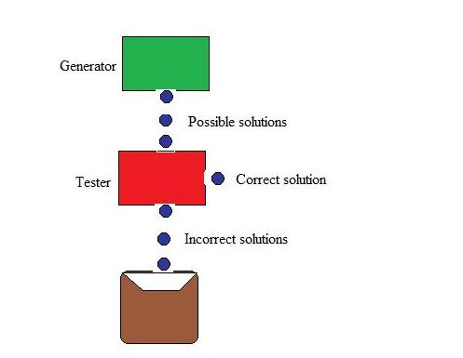
Generate-And-Test Algorithm (cont….)

Slide 10
Generate-And-Test Algorithm (cont….)
Requires complete solutions be generated for testing (like Depth First Search)
In its most systematic form, it is only an exhaustive search of the problem space
Solutions can also be generated randomly
but solution is not guaranteed.
Also known as British Museum algorithm: finding an object in the British Museum by wandering randomly.

Slide 11
Systematic Generate-And-Test
Two extreme approaches for G&T
generating complete solutions
generating random solutions
The intermediate approach
The search proceeds systematically but some paths that unlikely to lead the solution are not considered.
This evaluation is performed by a heuristic function.
E.g. Depth-first search tree with backtracking
Note : if some intermediate states are likely to appear often in the tree, it would be better to modify that procedure to traverse a graph rather than a tree.

Slide 12
Generate-And-Test And Planning
Exhaustive generate-and-test is very useful for simple problems.
For complex problems even heuristic generate-and-test is not very effective technique.
Combined with other techniques
E.g. An AI program DENDRAL used plan-Generate-and-test technique.
First the planning process uses constraint-satisfaction techniques and creates lists of recommended and contraindicated sub-structures.
Then the G&T procedure uses the lists generated and required to explore only a limited set of structures.
Major weakness : It often produces inaccurate solutions as there is no feedback from the world.
If it is used to produce only pieces of solutions then lack of detailed accuracy becomes unimportant.

Slide 13
Brute force Techniques
Generate-And-Test
Breadth-First Search
Uniform-Cost Search
Depth-First Search
Depth-First Iterative-Deepening Search
Bidirectional Search

Slide 14
Breadth First Search (BFS)
Searches breadth-wise in the problem space
like traversing a tree
where each node is a state which may a be a potential candidate for solution.
expands nodes from the root of the tree and then generates one level of the tree at a time until a solution is found.
implemented by maintaining a queue of nodes
Initially the queue contains just the root.
In each iteration, node at the head of the queue is removed and then expanded.
The generated child nodes are then added to the tail of the queue.

Slide 15
Algorithm: Breadth-First Search
Create a variable called NODE-LIST and set it to the initial state.
Loop until the goal state is found or NODE-LIST is empty.
Remove the first element, say E, from the NODE-LIST. If NODE-LIST was empty then quit.
For each way that each rule can match the state described in E do:
Apply the rule to generate a new state.
If the new state is the goal state, quit and return this state.
Otherwise add this state to the end of NODE-LIST

Slide 16
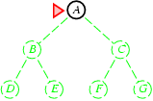
Breadth-First Search
Expand shallowest unexpanded node
Fringe: nodes waiting in a queue to be explored
Implementation:
fringe is a first-in-first-out (FIFO) queue, i.e., new successors go at end of the queue.
Is A a goal state?

Slide 17
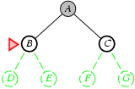
Breadth-First Search
Expand shallowest unexpanded node
Implementation:
fringe is a FIFO queue, i.e., new successors go at endc
Expand:
fringe = [B,C]
Is B a goal state?
17

Slide 18
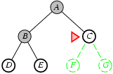
Breadth-first search
Expand shallowest unexpanded node
Implementation:
fringe is a FIFO queue, i.e., new successors go at end
Expand:
fringe=[C,D,E]
Is C a goal state?

Slide 19
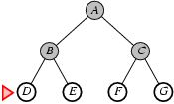
Breadth-first search
Expand shallowest unexpanded node
Implementation:
fringe is a FIFO queue, i.e., new successors go at end
Expand:
fringe=[D,E,F,G]
Is D a goal state?

Slide 20
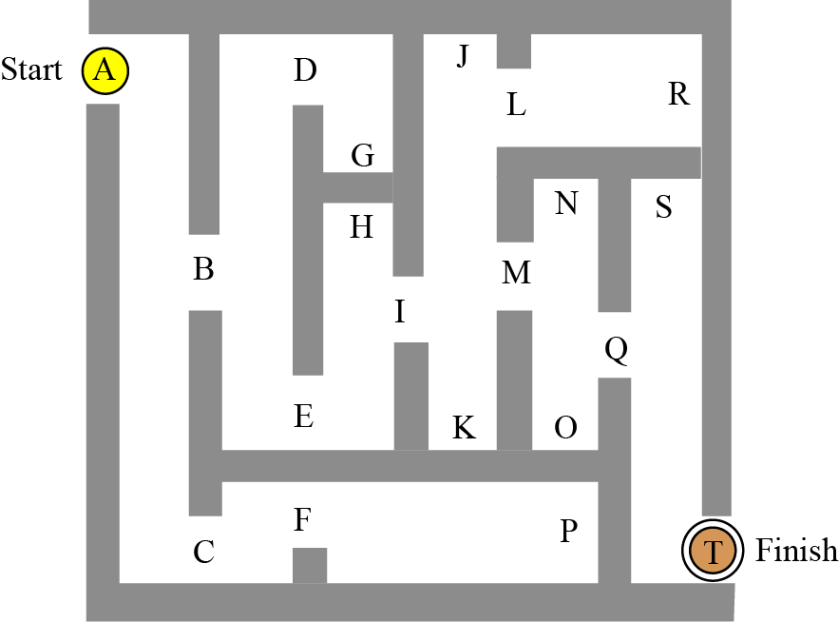
Example : The Maze Problem
find our way through the maze in Figure
A : Starting Point
T : finishing point

Slide 21
Example : The Maze Problem
The state space is
Initial state :A
Goal state : T
Set of neighboring nodes
e.g. (A,B), (A,C) , (B,D), (B,E) ……

Slide 22
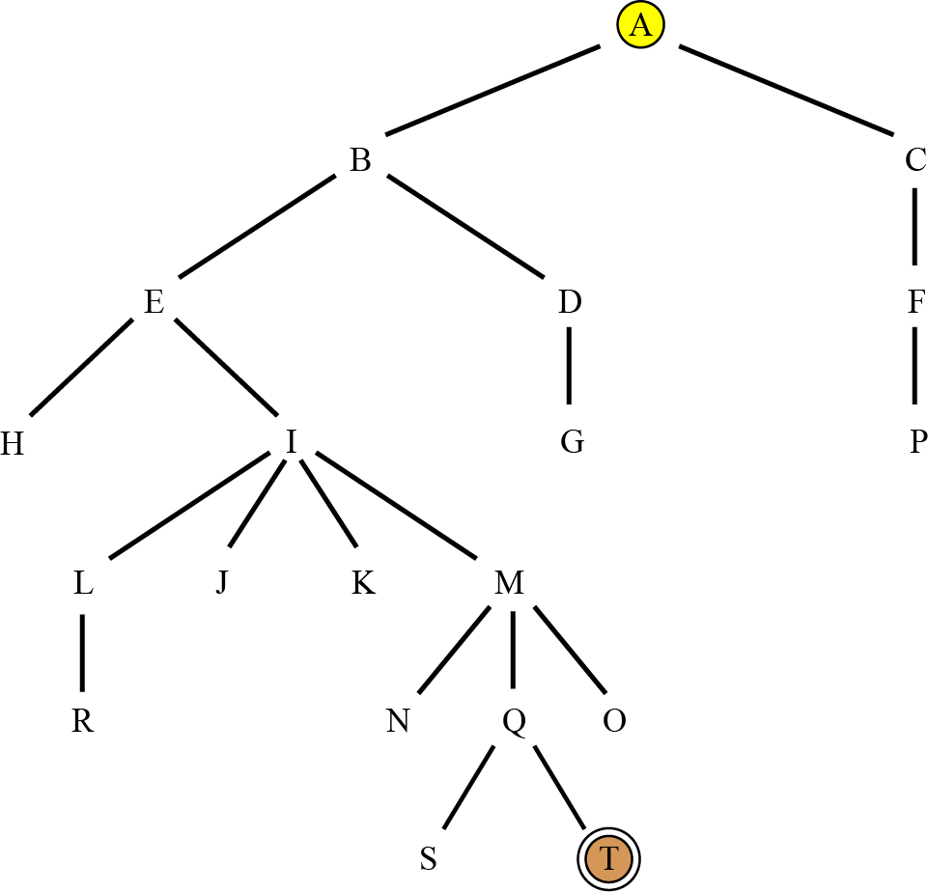
Maze as a graph search Problem

Slide 23
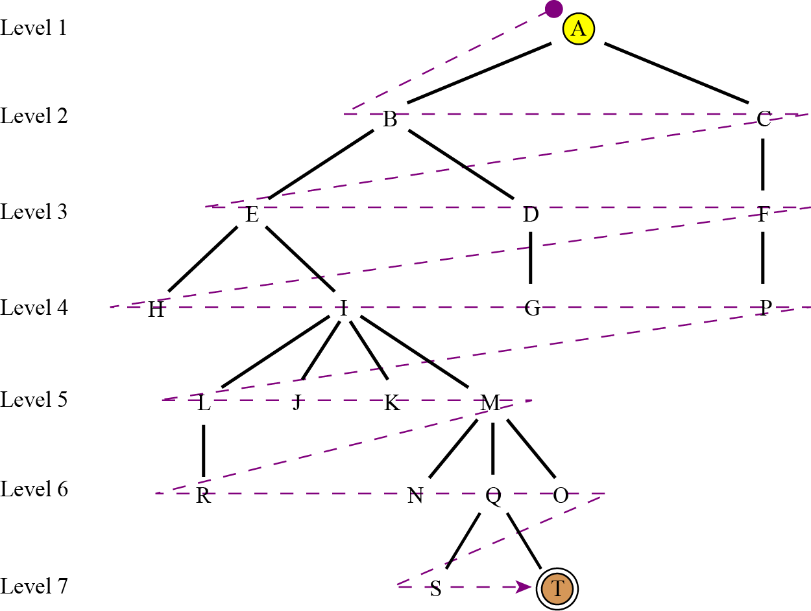
Breadth-first search of the tree

Slide 24
Example
BFS

Slide 25
Properties of breadth-first search
Complete? Yes it always reaches goal (if b is finite)
d= the depth of the shallowest solution
b = number of nodes in level i
Time? 1+b+b²+b³+… +b^{d} + (b^{d+1}-b)) = O(b^{d+1})
(this is the number of nodes we generate)
Space? O(b^{d+1}) (keeps every node in memory, either in fringe or on a path to fringe).
Fringe Space ? O(b X d)
Optimal? Yes (if we guarantee that deeper solutions are less optimal, e.g. step-cost=1).
Space is the bigger problem (more than time)

Slide 26
Properties of breadth-first search (Self study)
Since it never generates a node in the tree until all the nodes at shallower levels have been generated
breadth-first search always finds a shortest path to a goal.
Since each node can be generated in constant time,
the amount of time used by Breadth first search is proportional to the number of nodes generated, which is a function of the branching factor b and the solution d.
Since the number of nodes at level d is b^{d}, the total number of nodes generated in the worst case is b + b² + b³ +… + b^{d}
i.e. O(b^{d}) , the asymptotic time complexity of breadth first search.

Slide 27
Properties of breadth-first search
Advantages of BFS
It will never get trapped exploring the useless path forever.
If there is a solution, BFS will definitely find it out.
If there is more than one solution then BFS can find the minimal one that requires less number of steps.
Disadvantages of BFS
The main drawback is its memory requirement.
Since each level of the tree must be saved in order to generate the next level, and the amount of memory is proportional to the number of nodes stored, the space complexity of BFS is O(b^{d}).
As a result, BFS is severely space-bound in practice so will exhaust the memory available on typical computers in a matter of minutes.
If the solution is farther away from the root, breath first search will consume lot of time.

Slide 28
Brute force Techniques
Generate-And-Test
Breadth-First Search
Uniform-Cost Search
Depth-First Search
Depth-First Iterative-Deepening Search
Bidirectional Search

Slide 29
Uniform-Cost Search Algorithm
If all the edges in the search graph do not have the same cost then BFS is generalizes to uniform-cost search
traversing via different edges might not have the same cost.
goal is to find a path where the cumulative sum of costs is the least.
Cost of a node is defined as:
cost(node) = cumulative cost of all nodes from root
cost(root) = 0
Fringe : The nodes are stored in a priority queue.
also known as Dijkstra’s single-source shortest algorithm.

Slide 30
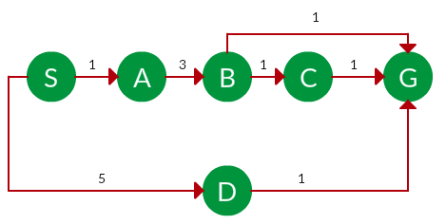
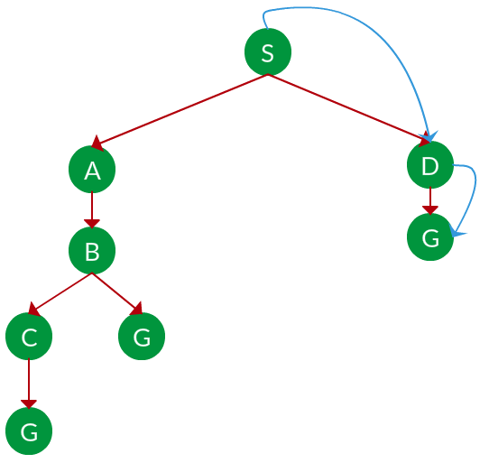
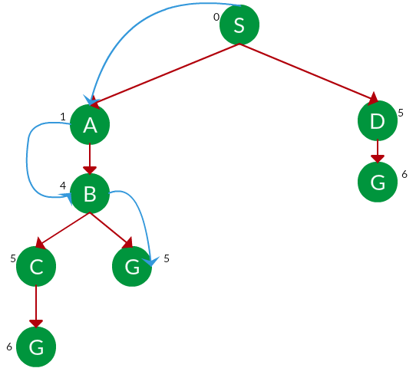
UCS Example
Path: S → G
Path: S → A → B → G
BFS Path: S →D→ G

Slide 31
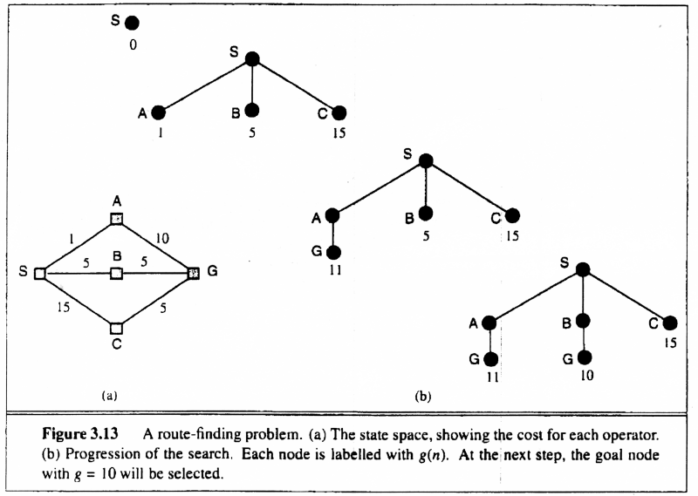
UCS Example

Slide 32
UCS Complexity Analysis
UCS expands nodes in order of their cost from the root.
At each step, the next step n to be expanded is one whose cost g(n) is lowest where g(n) is the sum of the edge costs from the root to node n.
implementation: fringe = queue ordered by path cost
Equivalent to breadth-first if all step costs all equal.
Complete? Yes, if step cost ≥ ε (otherwise it can get stuck in infinite loops)
Time? No. of nodes with path cost ≤ cost of optimal solution.
The worst case time complexity of UCS : O(b^{c}/m),
where c is the cost of an optimal solution and m is the minimum edge cost.
Space? No. of nodes on paths with path cost ≤ cost of optimal solution
Same memory limitation as BFS.
Optimal? Yes, for any step cost ≥ ε

Slide 33
Uniform-cost search (Self study)
Proof Completeness:
Given
that every step will cost more than 0,
and assuming a finite branching factor,
finite number of expansions required before the total path cost is equal to the path cost of the goal state
Hence, we will reach it.
Proof of optimality given completeness:
Assume UCS is not optimal.
Then there must be a goal state with path cost smaller than the goal state which was found (invoking completeness).
However, this is impossible because UCS would have expanded that node first by definition Contradiction.

Slide 34
Pros and Cons of UCS
Advantages:
UCS is complete only if states are finite and there should be no loop with zero weight.
UCS is optimal only if there is no negative cost.
Disadvantages:
Explores options in every “direction”.
No information on goal location.

Slide 35
straight-line distances
A
6
D
1
F
3
1
h(S-G)=10
h(A-G)=7
h(D-G)=1
h(F-G)=1
h(B-G)=10
h(E-G)=8
h(C-G)=20
S
2
4
8
G
B
E
1
20
C
The graph above shows the step-costs for different paths going from the start (S) to
the goal (G). On the right you find the straight-line distances.
Use uniform cost search to find the optimal path to the goal.
Exercise for at home

Slide 36
Brute force Techniques
Generate-And-Test
Breadth-First Search
Uniform-Cost Search
Depth-First Search
Depth-First Iterative-Deepening Search
Bidirectional Search

Slide 37
Depth First Search Algorithm
Depth First Search (DFS) searches deeper into the problem space.
BFS search always generates successor of the deepest unexpanded node (FIFO-QUEUE).
DFS uses last-in first-out stack for keeping the unexpanded nodes (stack).
Algorithm: Depth First Search
If the initial state is a goal state, quit and return success.
Otherwise, loop until success or failure is signaled.
Generate a state, say E, and let it be the successor of the initial state. If there is no successor, signal failure.
Call Depth-First Search with E as the initial state.
If success is returned, signal success. Otherwise continue in this loop.

Slide 38
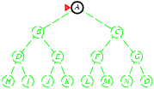
Depth-first search
Expand deepest unexpanded node
Implementation:
fringe = Last In First Out (LIFO) queue, i.e., put successors at front
Is A a goal state?

Slide 39
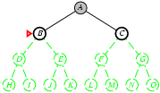
Depth-first search
Expand deepest unexpanded node
Implementation:
fringe = LIFO queue, i.e., put successors at front
queue=[B,C]
Is B a goal state?

Slide 40
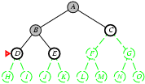
Depth-first search
Expand deepest unexpanded node
Implementation:
fringe = LIFO queue, i.e., put successors at front
queue=[D,E,C]
Is D = goal state?

Slide 41
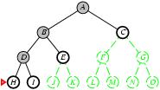
Depth-first search
Expand deepest unexpanded node
Implementation:
fringe = LIFO queue, i.e., put successors at front
queue=[H,I,E,C]
Is H = goal state?

Slide 42
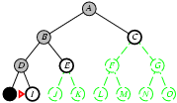
Depth-first search
Expand deepest unexpanded node
Implementation:
fringe = LIFO queue, i.e., put successors at front
queue=[I,E,C]
Is I = goal state?

Slide 43
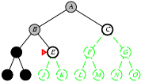
Depth-first search
Expand deepest unexpanded node
Implementation:
fringe = LIFO queue, i.e., put successors at front
queue=[E,C]
Is E = goal state?

Slide 44
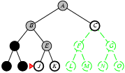
Depth-first search
Expand deepest unexpanded node
Implementation:
fringe = LIFO queue, i.e., put successors at front
queue=[J,K,C]
Is J = goal state?

Slide 45
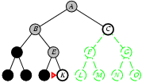
Depth-first search
Expand deepest unexpanded node
Implementation:
fringe = LIFO queue, i.e., put successors at front
queue=[K,C]
Is K = goal state?

Slide 46
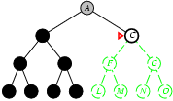
Depth-first search
Expand deepest unexpanded node
Implementation:
fringe = LIFO queue, i.e., put successors at front
queue=[C]
Is C = goal state?

Slide 47
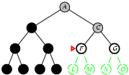
Depth-first search
Expand deepest unexpanded node
Implementation:
fringe = LIFO queue, i.e., put successors at front
queue=[F,G]
Is F = goal state?

Slide 48
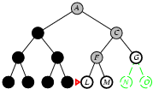
Depth-first search
Expand deepest unexpanded node
Implementation:
fringe = LIFO queue, i.e., put successors at front
queue=[L,M,G]
Is L = goal state?

Slide 49
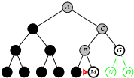
Depth-first search
Expand deepest unexpanded node
Implementation:
fringe = LIFO queue, i.e., put successors at front
queue=[M,G]
Is M = goal state?

Slide 50
Properties of depth-first search
A
Complete? No: fails in infinite-depth spaces (loop or Cycle)
Can modify to avoid repeated states along path
d= the depth of the shallowest solution
bi = number of nodes in level I
Time? : T(b) = 1+b+b²+b³+… +b^{d} + (b^{d+1}-b)) = O(b^{d+1})
O(b^{m}) with m=maximum depth
terrible if m is much larger than d
but if solutions are dense, may be much faster than
breadth-first
Space? O(bXm), i.e., linear space! (we only need to remember a single path + expanded unexplored nodes) (figure in next slide)
Optimal? No (It may find a non-optimal goal first)
B
C

Slide 51
Example DFS

Slide 52
Pros and Cons of DFS
Advantages of Depth-First Search
memory requirement is linear with respect to the search graph.
Only needs memory to store a stack of nodes on the path from the root to the current node.
The time complexity is O(b^d)
As it generates the same set of nodes as BFS, but simply in a different order.
Thus practically depth-first search is time-limited rather than space-limited.
If depth-first search finds solution without exploring much in a path then the time and space it takes will be very less.

Slide 53
Pros and Cons of DFS (cont…)
Disadvantages of Depth-First Search
There is a possibility that it may go down the left-most path forever.
Even a finite graph can generate an infinite tree.
One solution to this problem is to impose a cutoff depth on the search.
Although the ideal cutoff is the solution depth d and this value is rarely known in advance of actually solving the problem.
If the chosen cutoff depth is less than d, the algorithm will fail to find a solution, whereas if the cutoff depth is greater than d, a large price is paid in execution time, and the first solution found may not be an optimal one.
It is not guaranteed to find the solution.
And there is no guarantee to find a minimal solution
if more than one solution exists.

Slide 54
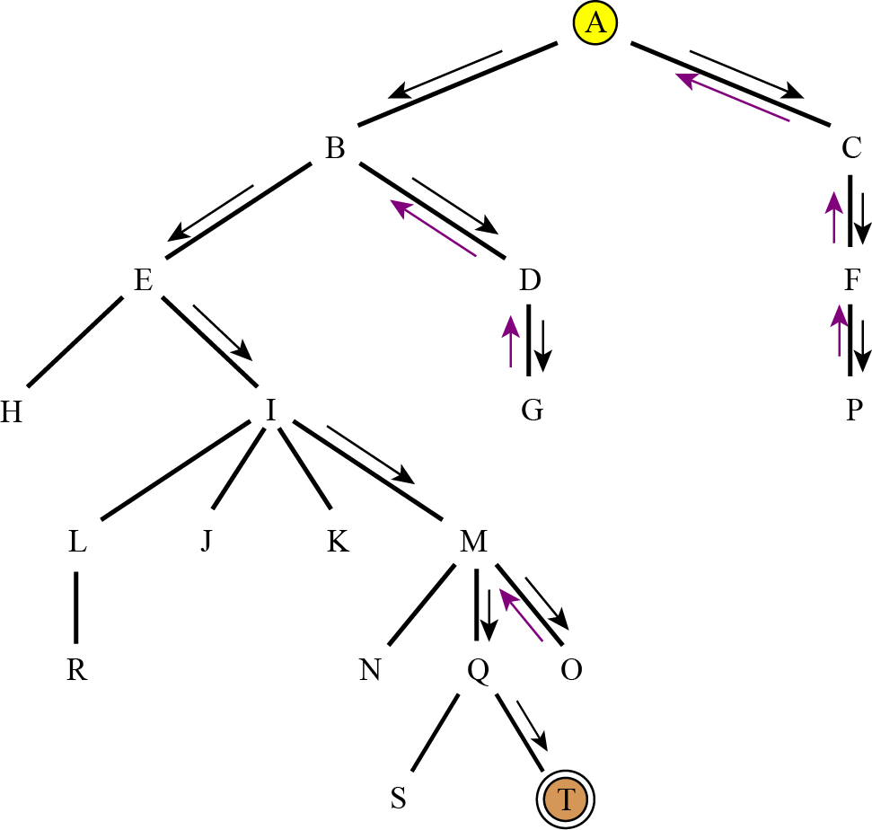
Depth-first search of the tree

Slide 55
Brute force Techniques
Generate-And-Test
Breadth-First Search
Uniform-Cost Search
Depth-First Search
Depth-First Iterative-Deepening Search
Bidirectional Search

